Slide 1
Object Oriented Analysis
Object-Oriented Analysis (OOA) is a structured method for analyzing and designing a software system by visualizing it as a collection of interacting objects, each representing a real-world entity or concept. This approach is particularly beneficial during the requirements engineering phase, as it helps to clearly identify and organize requirements into manageable components.

Slide 2
Key Goals of Object Oriented Analysis
Understand the System Requirements: Define what the system is supposed to do.
Model Real-World Entities: Represent system components as objects with attributes and behaviors.
Establish Relationships: Identify interactions and relationships between objects.
Support Reusability and Maintainability: Create modular and scalable systems.

Slide 3
Example (Online Library Management System)
Understand the System Requirements:
The system should allow users to search for books, borrow them, and return them.
Librarians should be able to manage books, track borrowed books, and handle fines for overdue returns.
Model Real-World Entities:
Objects Identified:
Book: Attributes: title, author, ISBN, availability. Methods: checkAvailability(), updateStatus().
User: Attributes: userId, name, borrowedBooks. Methods: borrowBook(), returnBook().
Librarian: Attributes: employeeId, name, role. Methods: addBook(), removeBook(), issueFine().
Transaction: Attributes: transactionId, userId, bookId, borrowDate, returnDate. Methods: recordTransaction(), calculateFine().

Slide 4
Example (Online Library Management System)..
Establish Relationships:
A User can borrow multiple Books (association: one-to-many).
A Book can only be borrowed by one User at a time (association: one-to-one).
A Librarian manages multiple Transactions (association: one-to-many).
Transaction links User and Book for tracking purposes.
Support Reusability and Maintainability:
Define a Person superclass for shared attributes like name and methods like getDetails() for User and Librarian, enabling inheritance.
Use modular design so that new features, like a digital book system, can be easily integrated by adding a DigitalBook subclass under Book.

Slide 5
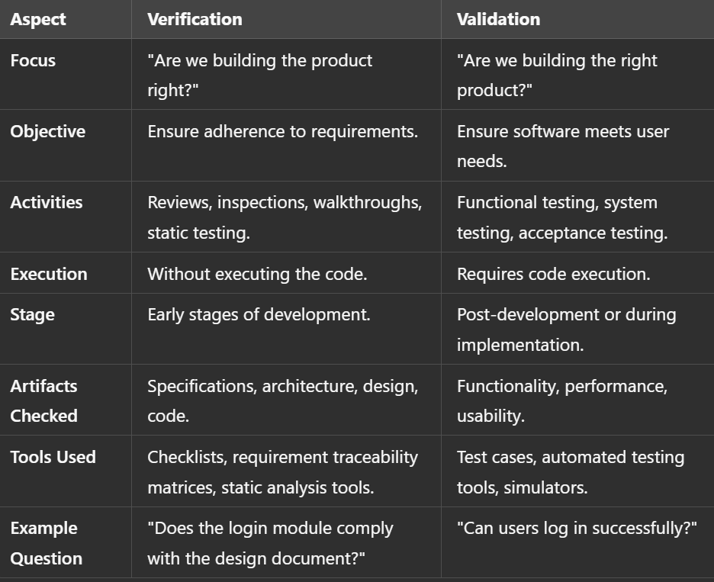
Verification vs Validation

Slide 6
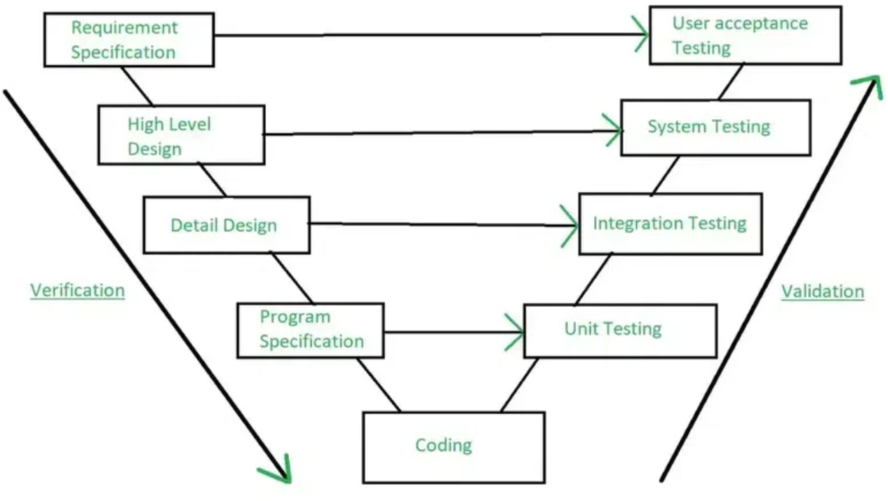
Verification vs Validation..

